Slide 1

Airline safety
Disha Saha
Final Project
DSC 640

Slide 2
The Scenario
Due to recent unfortunate airline crashes, the media has been promoting statistics stating air is no longer a safe way to travel. The news and media outlets have been bombarding the public with reports and figures about the trends of airline safety and that things are not looking good. What was previously thought as the safest way to travel, especially when compared to automobiles, is now being presented as one of the most dangerous to the public. But are any of these claims based on facts?

Slide 3
Itinerary
Flying compared to other methods of Travel
Review Metrics
Concluding Remarks

Slide 4
Flying compared to other ways of Travel
“According to the Research and Innovative Technology Administration with the Bureau of Transportation Statistics, Americans in 2008 traveled 2,553,043,000,000 miles in cars, 583,506,000,000 miles via commercial aviation and 16,850,000,000 miles by rail”
Looking at the number of deaths per 100 million miles traveled in the US:
TRAIN RELATED: 4.40 People being killed by a train in any fashion via FRAOSA
OTHER AUTO: 1.73 Motorcycles, pedestrians, auto related
AUTOS: 1.33 Only passenger vehicles
PASSENGER TRAIN: 0.13 People dying on the train via FRAOSA
COMMERCIAL AIRLINES: 0.0077 2009: 0.0077 2008: 0.0000 2007: 0.0000
Source: David Parker Brown
Link to Article

Slide 5
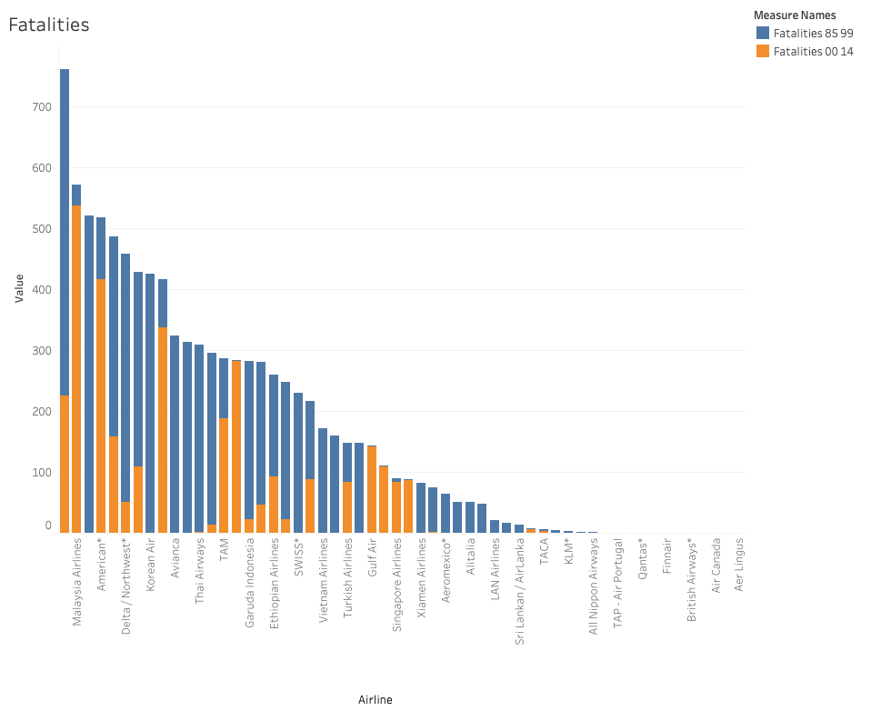
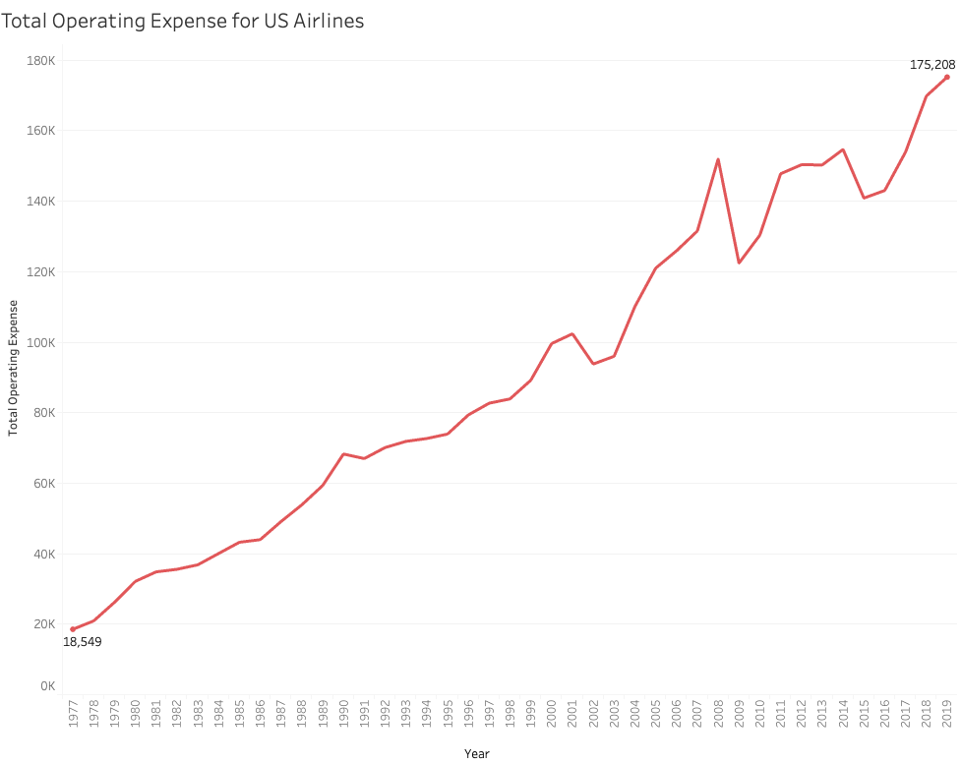
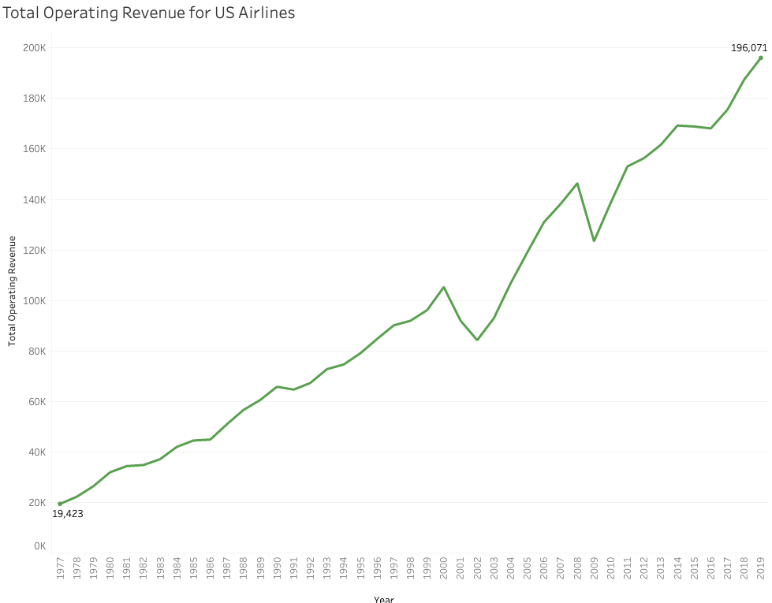
Major Airline Fatalities

Slide 6
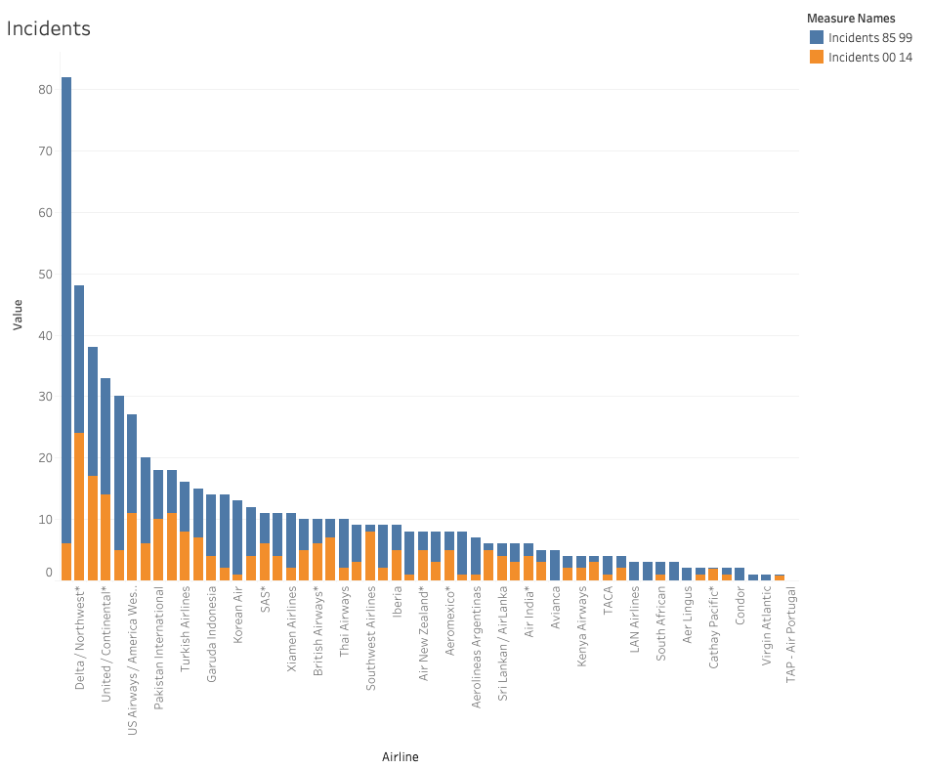
Major Airline Incidents

Slide 7
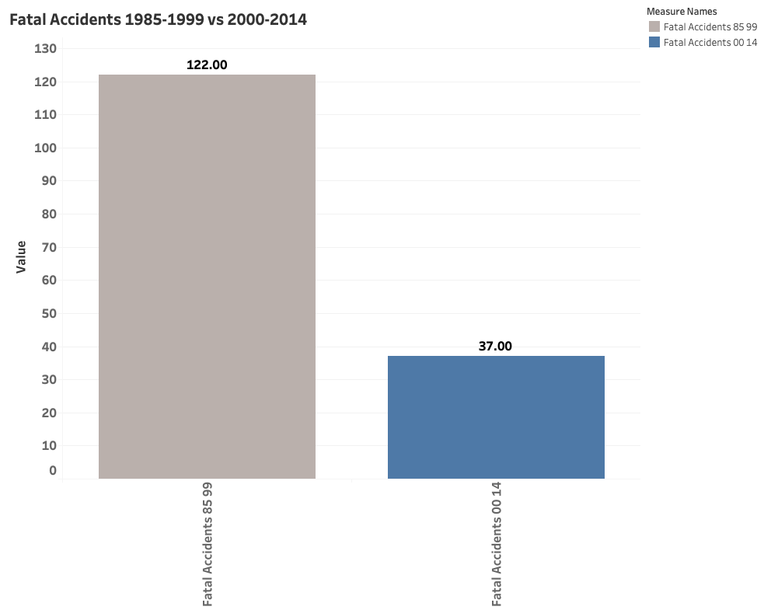
Airline Fatal Accidents

Slide 8
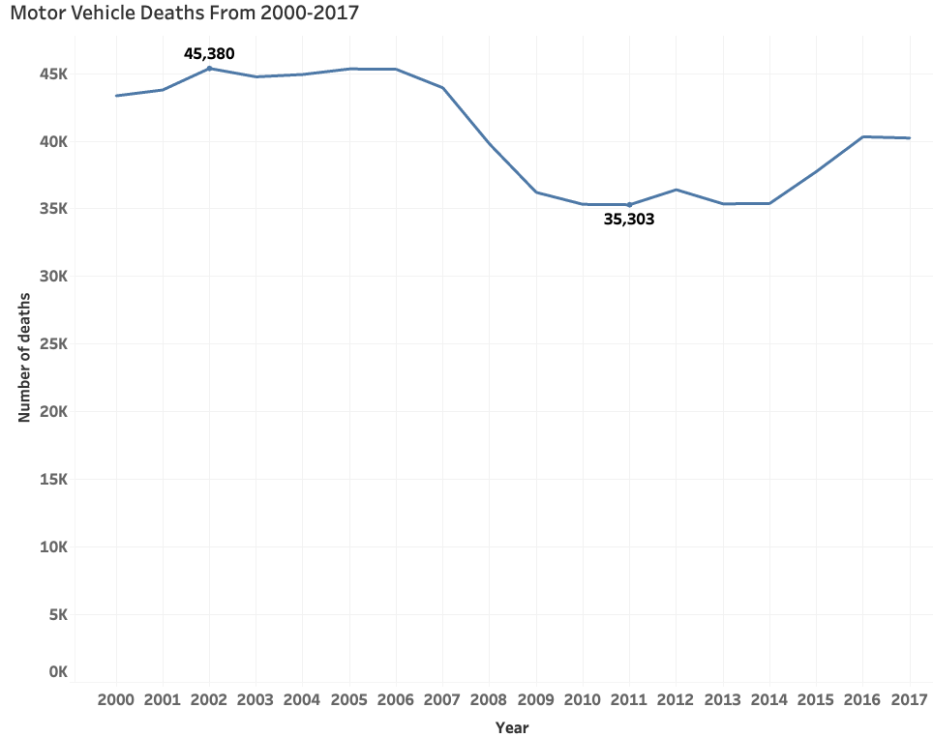
Moto Vehicle Deaths

Slide 9
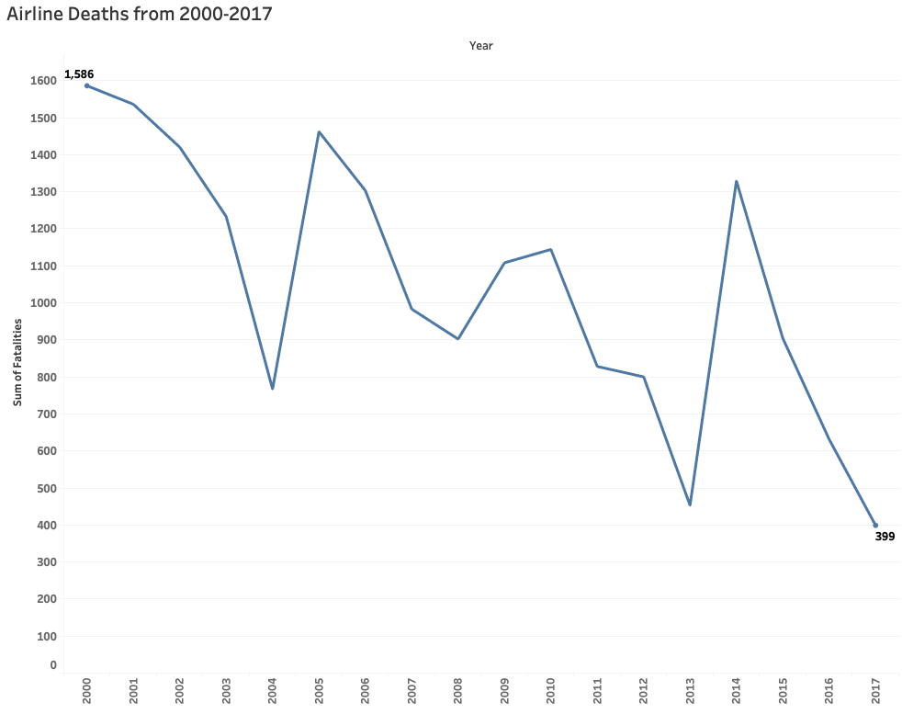
Airline Deaths

Slide 10
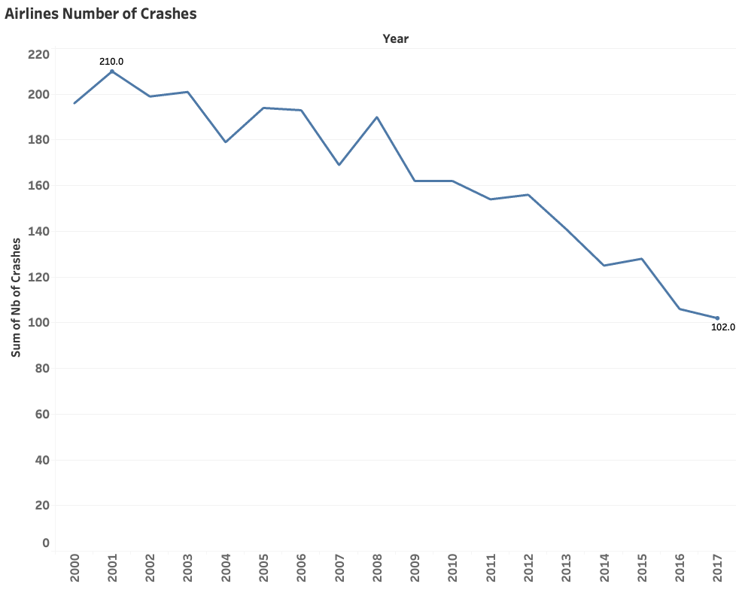
Airline Number of Crashes

Slide 11
Conclusion
Airline travel is still a safe way to travel
Overall Major Airlines have decreased the number of fatalities over the past 30 years.
Major Airline Incidents have decreased over the past 15 years.

Slide 12
References
Comparison of Other Methods of travel Article
https://www.airlinereporter.com/2010/09/flying-is-safe-and-i-am-going-to-prove-it/
Data Sources
https://github.com/fivethirtyeight/data/tree/master/airline-safety
http://www.baaa-acro.com/statistics/crashs-rate-per-year
http://www.baaa-acro.com/statistics/death-rate-per-year
https://injuryfacts.nsc.org/motor-vehicle/historical-fatality-trends/deaths-and-rates/

